Slide 1
Project Title: STP Attacks and Protection Mechanisms This project explores common attacks on the Spanning Tree Protocol (STP), such as BPDU spoofing and root bridge manipulation, and demonstrates effective countermeasures to secure network topology.

Slide 2
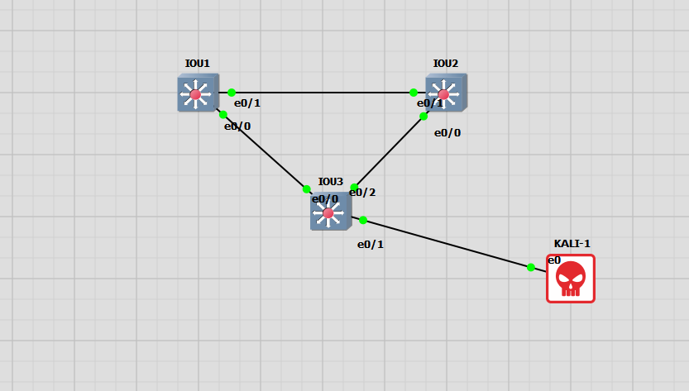





Slide 3
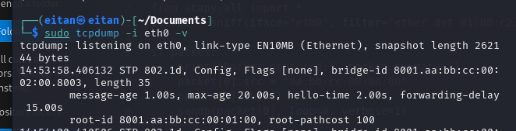
Switches flood STP frames on all active ports by default .
I Captured a STP frame sourced from Sw3.
Identified the lowest mac-address. And the lowest bridge priority in the network.
I need this info to create the malicious script.
DECIMAL | HEXADECIMAL | Value
32769(Vlan -id + 32768) | 8001 | Root Bridge Priority
No need to do that ☺ | aa:bb:cc:00:01:00 | Root Mac-address
128 | 80 | Port-Priority

Slide 4
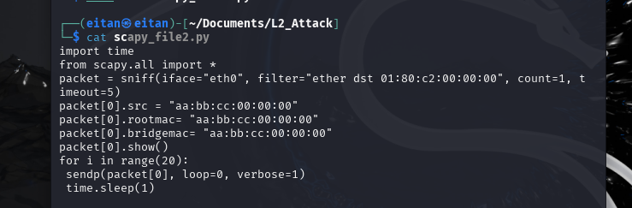
The script Captures a configuration BPDU packet, alters it and sends it 20 times back on the wire.
I leave the bridge/root priority at 32769(32768+vlan id)
Change the sending bridge mac to “aa:bb:cc:00:00:00”, which is the lowest
And most preferred.
declare it as the root mac.

Slide 5
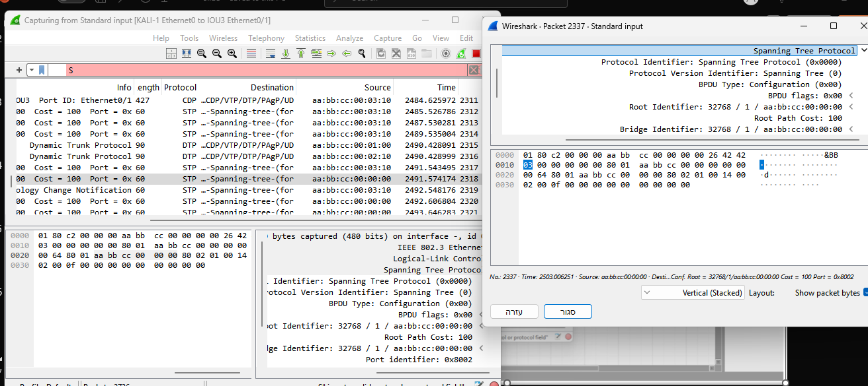
Wireshark capture - KALI-1_Ethernet0_to_IOU3_Ethernet01

Slide 6
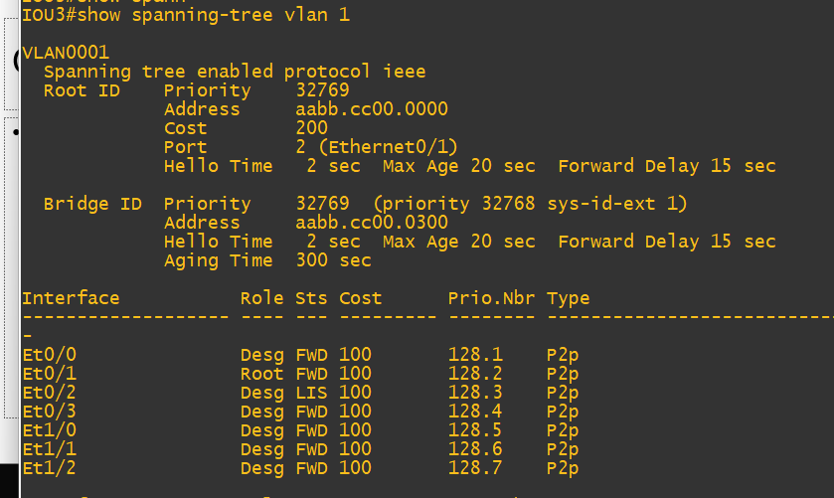

Slide 7
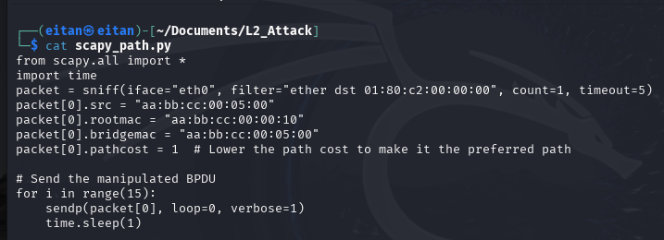
The Kali doesn’t self-declare as the ROOT, but claims to have a path to the root bridge(lowest mac) by manipulating the BPDU parameters. This could lead to the switch preferring the attacker’s BPDU over legitimate ones, potentially causing topology changes or disruptions in the network.

Slide 8
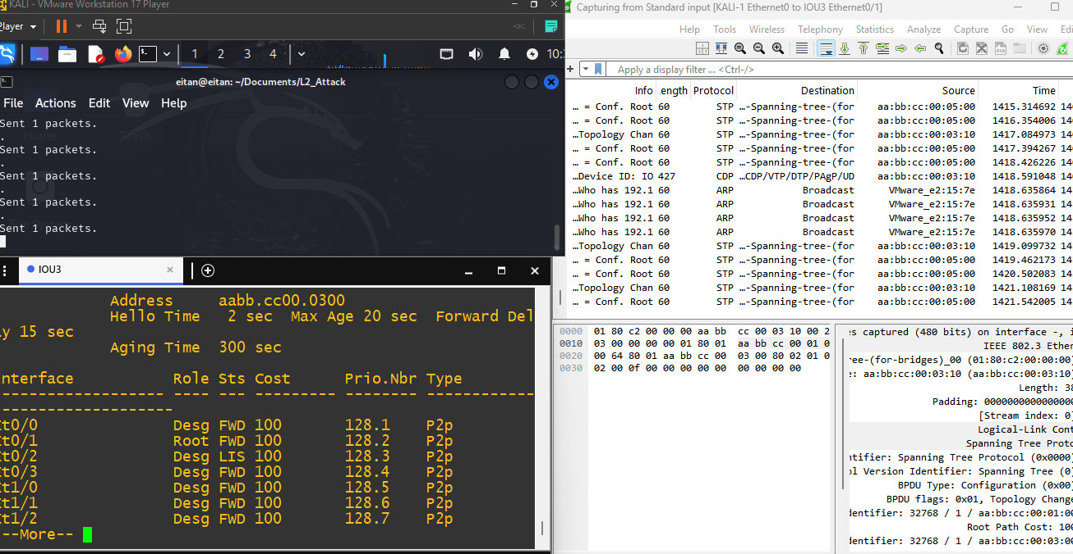
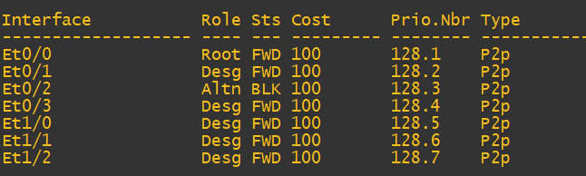



Before
After

Slide 9

Defense mechanisms
Root Guard – a Feature in STP that helps prevent an undesired switch from becoming the root bridge, It is applied on ports where you expect to connect non-root switches and want to enforce you desired root bridge placement.
Because the Kali-linux Vm is a End-Client and Not a Switch, we do not want to receive BPDU’s from it. So Root guard isn’t the solution here. the solution is…
BPDU Guard - protects the network by preventing unauthorized switches or devices, such as a Kali Linux machine, from injecting Bridge Protocol Data Units (BPDUs) into the network. When BPDU Guard is enabled on an interface (typically an access port), it automatically shuts down the port if any BPDU is received. This prevents an attacker using a Kali machine from attempting to become the root bridge by sending fake superior BPDUs, which could lead to a network topology change or even a denial of service. Enabling BPDU Guard on all access ports ensures that only legitimate switches participate in STP, enhancing network security and stability.

Slide 10
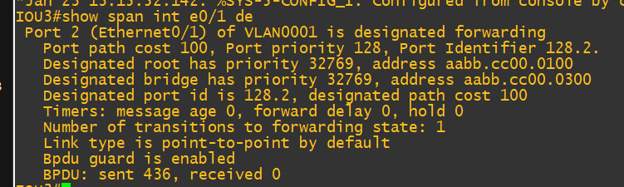



“show spanning-tree interface e0/1 detail” output shows bpdu guard is enabled, 436 bpdu’s sent, 0 received. Now we will try to send a manipulated BPDU and see what happens
IOU3>enable
IOU3#conf t
IOU3(config)#interface e0/1
IOU3(config)#spanning-tree bpduguard enable

Slide 11
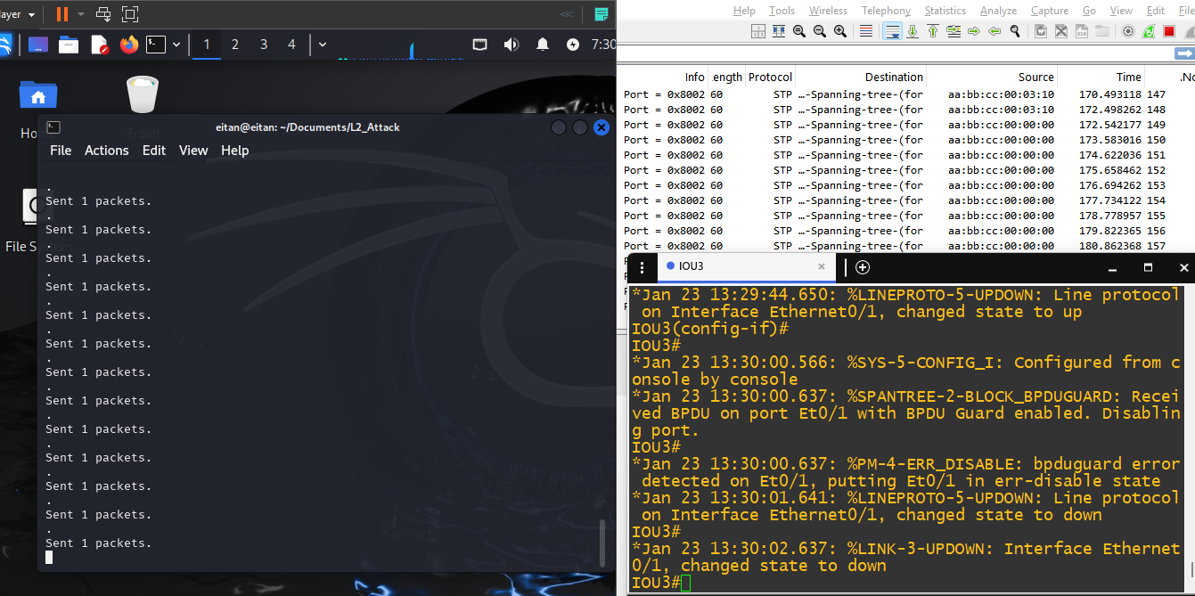


Slide 12
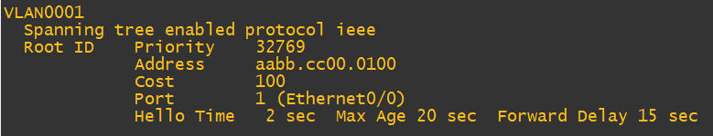
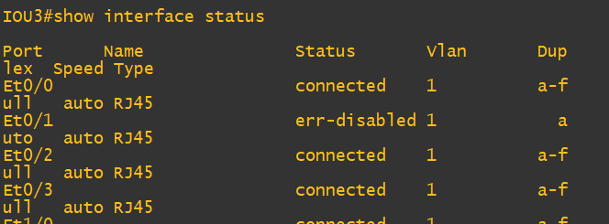

- Original Root-Bridge kept its role
- As can be reviewed in Wireshark the traffic was sent on the wire but the IOU3 didn’t process it because the 0/1 ethernet interface went down as the first BPDU was received.
- Lets configure an automatic recovery of the er-disable mode
After 60 seconds the port will recover back to an Up state.

